Slide 1

Imperial Credit Prediction
Group 3
Alex Payne, Angel Hernandez, Araya Kramer, Mary Klaire Osborne

Slide 2
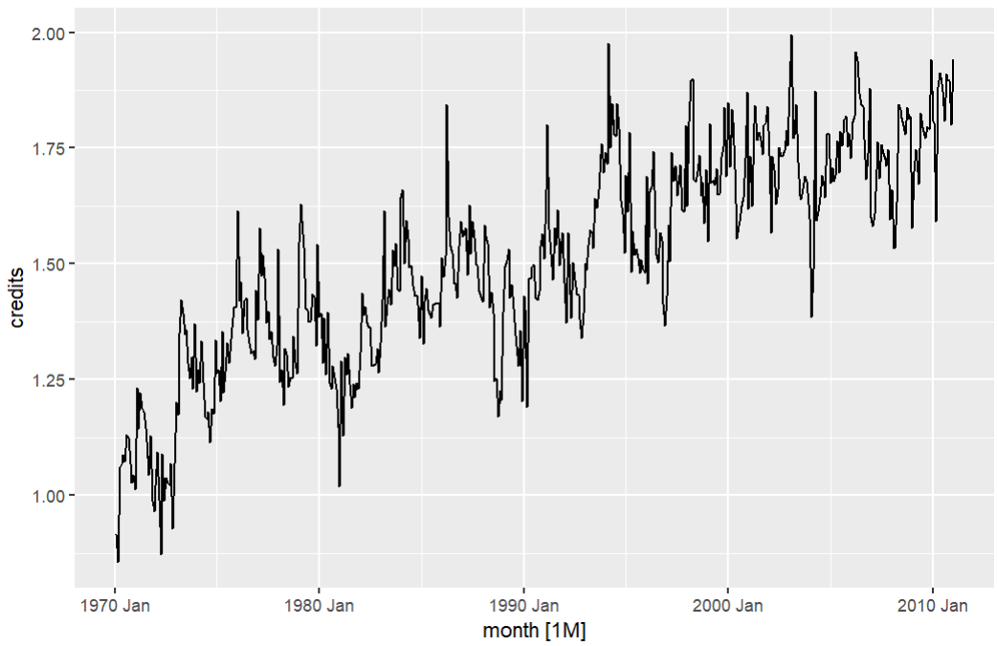
Complete Series Analysis
Complete Plot of our Imperial Credits in millions from 1970 - 2010
There is a clear upward trend
No Seasonality

Slide 3
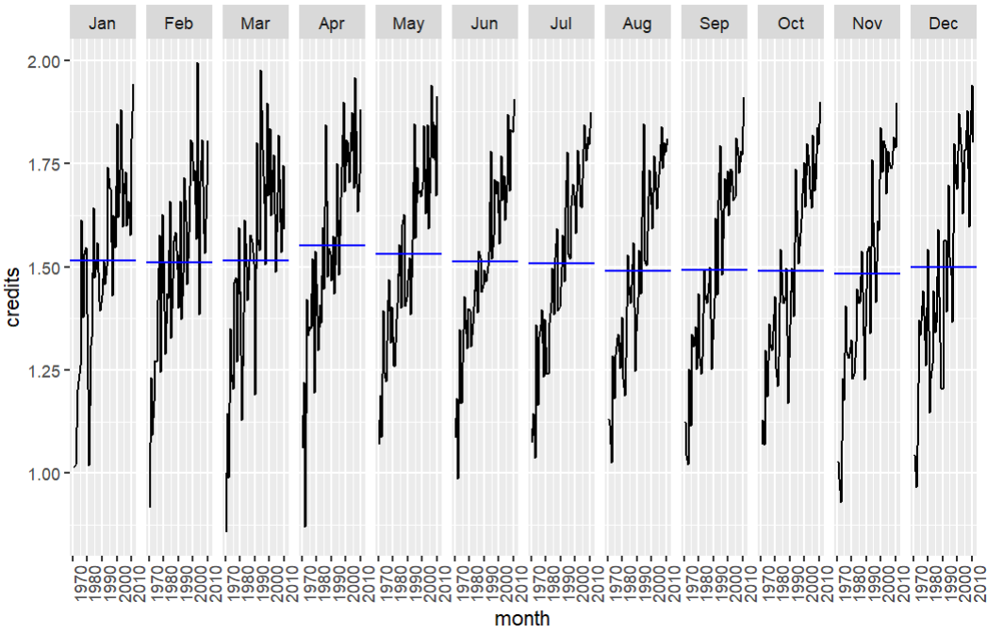
Seasonality
The average level of each month from 1970 - 2010 is indicated by the blue line
Since average credits each month is relatively the same, there is no clear seasonality

Slide 4
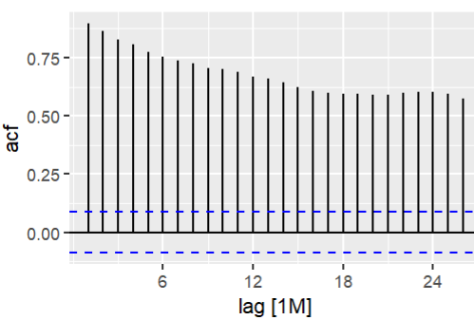
Autocorrelation is high
This means that a lot of the info of credits today can be predicted from the info from previous months

Slide 5
Model Results
Model Name | Predicted Value From Actual Value | Percentage From Actual
TSLM | $95,400 | 4.02%
TSLM + Fourier | $95,400 | 4.02%
Drift | $92,800 | 4.17%
Naive | $99,900 | 4.46%
Mean | $364,000 | 18.80%
ETS | $91,500 | 4.00%
ARIMA | $91,500 | 4.00%
Neural Net | $141,000 | 6.73%
Exact same so let’s compare them

Slide 6
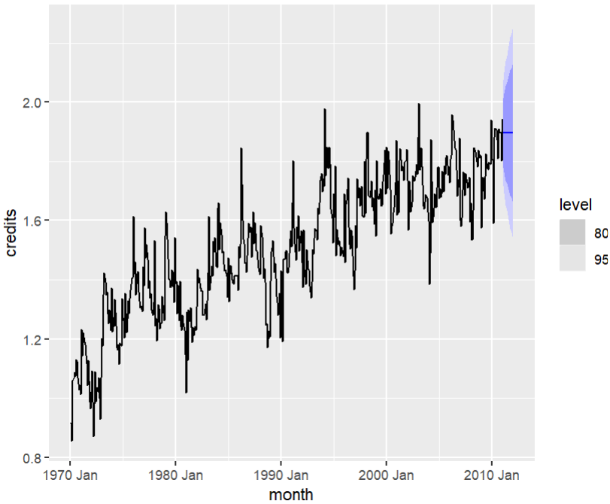
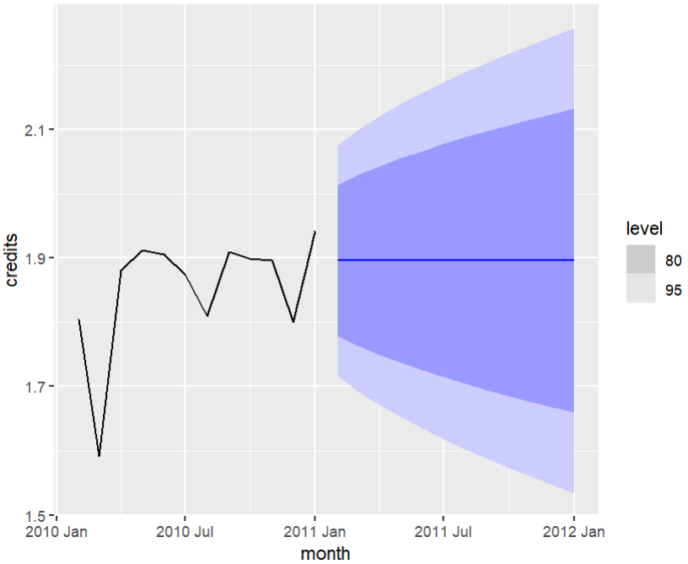
ETS (Exponential Smoothing)

Slide 7
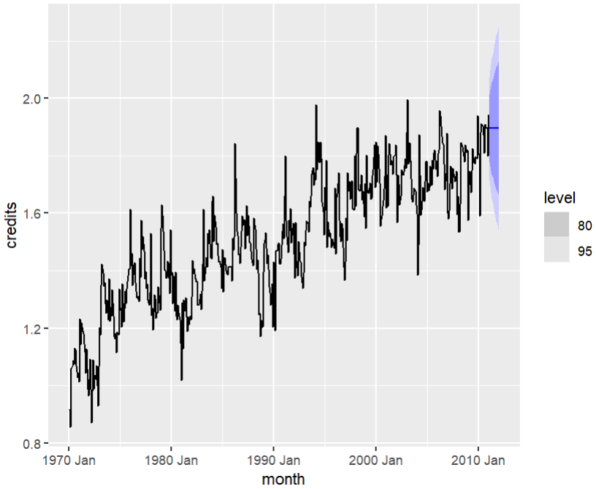

ARIMA

Slide 8
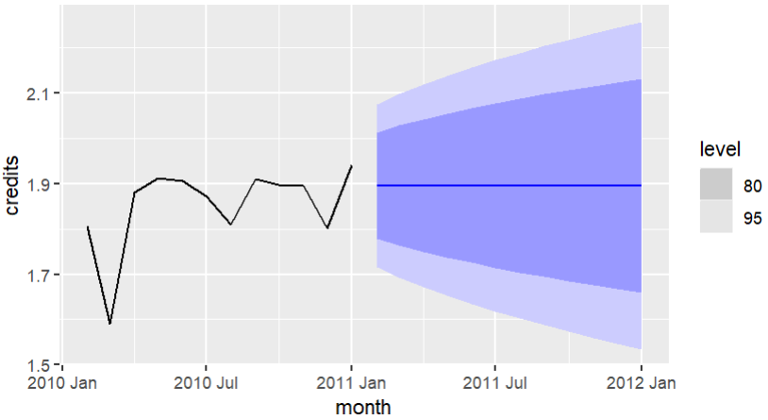
Final Model Selection: ETS
Since both models create the exact same prediction, we will choose the ETS model because it is a simpler model type
* The ETS, or Exponential Smoothing model, puts a weighted sum of past periods where the more recent the period, the more weight

Slide 9
One Year Imperial Credit Predictions
Month | Predicted Credits
February 2011 | 1,895,747
March 2011 | 1,895,747
April 2011 | 1,895,747
May 2011 | 1,895,747
June 2011 | 1,895,747
July 2011 | 1,895,747
August 2011 | 1,895,747
September 2011 | 1,895,747
October 2011 | 1,895,747
November 2011 | 1,895,747
December 2011 | 1,895,747
January 2012 | 1,895,747

